Slide 2
Unit 7: Output Analysis Method (5 hrs)
7.1 Nature of Problem
7.2 Estimation Method
7.3 Simulation Run Statistics
7.4 Replication of Runs
7.5 Elimination of Initial Bias

Slide 3
Output Analysis Method
Once you've run a simulation, you need to analyze the output to understand performance metrics like:
Average queue length
Server utilization
Waiting times
System throughput
But — since simulation involves randomness, you need statistical techniques to get reliable results.

Slide 4
Output Analysis Method
Output analysis is the analysis of data generated by a simulation run to predict system performance or compare the performance of two or more system designs.
In stochastic simulations, multiple runs are always necessary. The output of a single run can be viewed as a sample of size 1.

Slide 5
Output Analysis Method
Output analysis is needed because output data from a simulation exhibits random variability when random number generators are used. i.e., two different random number streams will produce two sets of output which (probably) will differ.
The statistical tool mainly used is the confidence interval for the mean.

Slide 6
Output Analysis Method
For most simulations, the output data are correlated, and the processes are non-stationary. The statistical (output) analysis determines:
The estimate of the mean and variance of random variables.
The number of observations required to achieve a desired precision of these estimates.

Slide 7
Nature of Problem
Once a stochastic variable has been introduced into a simulation model, almost all the system variables describing the system behaviour also become stochastic.
The values of most of the system variables will fluctuate as the simulation proceeds so that no one measurement can be taken to represent the values of a variable.

Slide 8
Nature of Problem
Instead, many observations of the variable values must be made to make a statistical estimate of its true values.
Some statement must also be made about the probability of the true value falling within the given interval of the estimated value.
Such a statement defines a confidence interval; without it, simulation results are of little value to the system analyst.

Slide 9
Nature of Problem
A large body of statistical methods have been developed over the years to analyze results in science, engineering, and other fields where experimental observation is made.
So, because of the experimental measurements of the system of simulation for these statistical methods can be adapted to the simulation results to analyze.

Slide 10
Nature of Problem
The Newly Developing Statistical Methodology Concerns:
To ensure that the statistical estimates are consistent, meaning that as the sample size increases estimate tends to a true value.
To control biasing in measure of both new values of variance. Bias causes the distinction of an estimate to differ significantly from the true population statistics, even though the estimate may be consistent.
To develop sequential testing methods, to determine how long a simulation should be run in order to obtain confidence in its return.

Slide 11
Estimation Method
Statistical methods are commonly used on the random variable.
Usually, a random variable is drawn from an infinite population with a finite mean ‘μ’ and finite variance ‘σ²’.
These random variables are independently and identically distributed (i.e. IID variables).
Let, x_{i}=iid random variables. (i = 1, 2…, n), Then, according to the central limit theorem and applying transformation, the approximate normal variance,

Slide 12
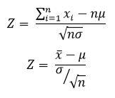

Estimation Method
Where $\overline{x}$ is sample mean

Slide 13
Estimation Method
It can be shown to be a consistent estimator for the mean of the population from which the sample is drawn.
Since the sample mean is some of the random variables, it is itself a random variable. So, a confidence interval about its computed value needs to be established.
The probability density function of the standard normal variable (Z) is shown in the figure below.

Slide 14
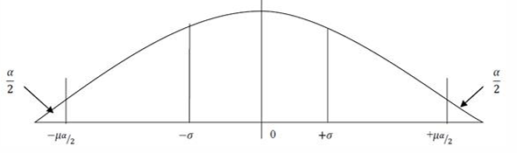
Estimation Method

Slide 15
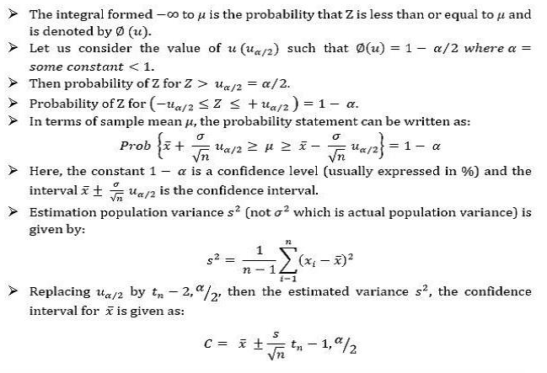
Estimation Method

Slide 16
Simulation Run Statistics
On every simulation run, some statistic is measured based on some assumption.
For example: on establishing confidence interval, it is assumed that the observations are mutually independent and distinction from which they are drawn is stationary.
But many statistics are interesting in simulation don’t meet this condition.
Let us illustrate the problems that arise in measuring statistics from a simulation run with the example of a single server system.

Slide 17
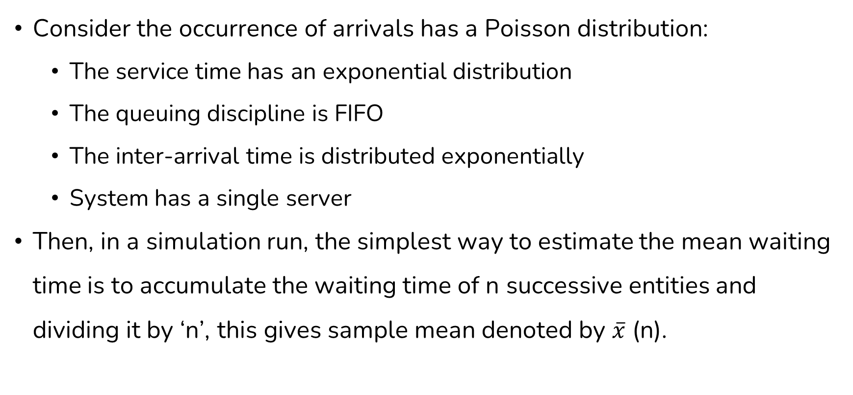
Simulation Run Statistics
Consider the occurrence of arrivals has a Poisson distribution:
The service time has an exponential distribution
The queuing discipline is FIFO
The inter-arrival time is distributed exponentially
System has a single server
Then, in a simulation run, the simplest way to estimate the mean waiting time is to accumulate the waiting time of n successive entities and dividing it by ‘n’, this gives sample mean denoted by $\overline{x}$ (n).

Slide 18
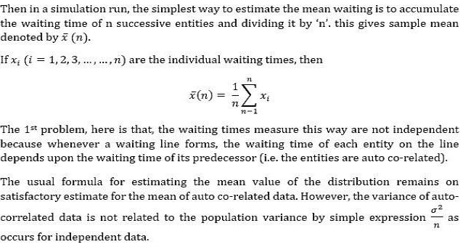
Simulation Run Statistics

Slide 19
Simulation Run Statistics
The 2nd problem is that the distribution may not be stationary; it is because a simulation run is started with the system in some initial state, frequently the idle state, in which no service is being given, and no entities are waiting
Thus, the early arrivals have a higher probability of obtaining service quickly. So, a sample means that includes the early arrivals will be biased.
As the length of the simulation run extends and the sample size increases, the effect of bias will be minimal.

Slide 20
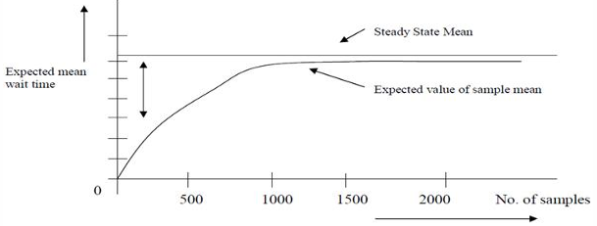
Simulation Run Statistics
This is shown as:

Slide 21
Replication of Runs
One problem in measuring the statistic in the simulation run is that the results are dependent.
But it is required, in simulation, to get the independent result.
The one way of obtaining the independent result is to repeat the simulation.
Repeating the experiment with different random numbers for the same sample size ‘n’ gives a set of an independent determination of sample mean x ̅(n).

Slide 22
Replication of Runs
Even though the distribution of the sample means depends upon the degree of autocorrelation, this independent determination of sample mean can be used to estimate the variance of the distribution.

Slide 23
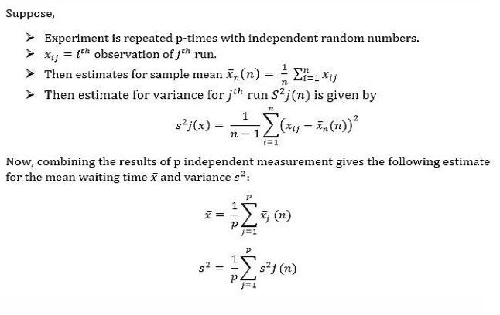
Replication of Runs

Slide 24

Replication of Runs
Here, the value of $\overline{x}$ is an estimate for the mean waiting time, and the value of s² can be used to establish the confidence intervals.

Slide 25
Elimination of Initial Bias
There two general approaches that can be used to remove the initial bias:
1. The system can be started in more representative states rather than in the empty state.
2. The first part of the simulation run can be ignored.

Slide 26
Elimination of Initial Bias
In the first approach, it’s essential to understand the steady-state distinction before selecting the initial state distinction.
In simulations of existing systems, available information about expected conditions can help select a better initial condition, reducing initial bias.

Slide 27
Elimination of Initial Bias
The second approach that is used to remove the initial bias is the most common.
In this method, the initial section of the run, which has a high bias (simulation) result, is eliminated.
The run starts from an idle state and stops after a satisfactory bias period.
Entities present in the system at that moment remain unchanged, serving as the restart point for future simulation runs.

Slide 28
Elimination of Initial Bias
Then the run is restarted with statistics being gathered from the point of the restart. These approaches have the following difficulties:
Determining the duration for eliminating an interval isn't straightforward. A pilot run from the ideal state can help assess how long the initial bias lasts. This can be visualized by plotting the measured statistics against the run length.
Eliminating the first part of the simulation run reduces the information available for estimating variance, which can lead to larger confidence intervals.

Slide 29
End of Lecture 20

Slide 30
Discussion

